Slide 1




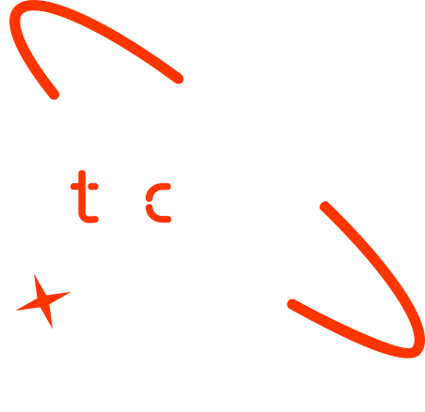

A new generation
of tech specialists

Slide 2
Predicting Poverty Level Using World Bank Indicators
Team Members:
Shabir Khairzad
Sultan Mansour Raofi
Arezo Mohammadi

Slide 3
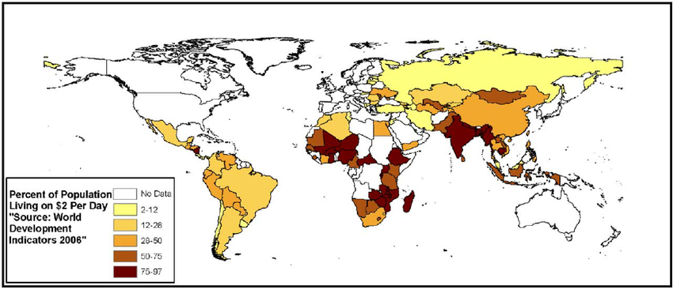
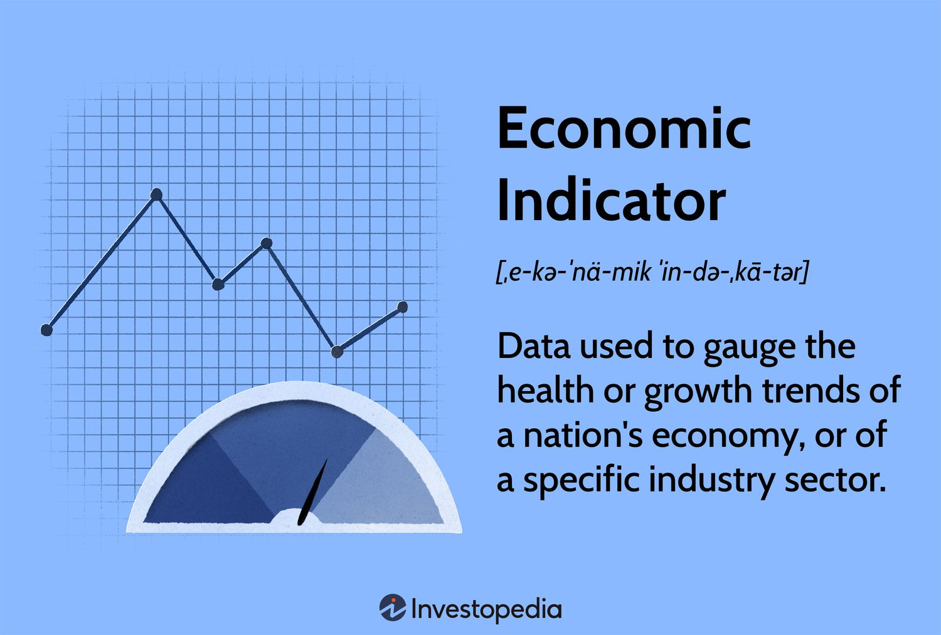
Outline
Concept Note and Implementation Plan:
Background & Objectives
SDG Relation & Data
Exploratory Data Analysis (EDA) and Feature Engineering
Model Selection, Training & Model Evaluation and Hyperparameter Tuning
Model Refinement and Hyperparameter Tuning
Results, Deployment & Future Work
Implementation Highlights:
Code Structure and GUI Interface
Interactive Data Visualization
User Guide & Additional Features

Slide 4
Background
Project Overview:
Addresses the challenge of outdated/incomplete poverty data by leveraging the World Bank Development Indicators (WDI).
Uses machine learning models to predict poverty levels and assist policymakers in targeted resource allocation.
Importance of the Problem:
Reliable, up-to-date poverty predictions help guide interventions and drive socioeconomic development.
Brief Background:
Traditional methods suffer from delays and inefficiencies.
Our approach employs modern ML techniques to analyze diverse socioeconomic data.

Slide 5
Objectives
Project Objectives:
Develop and deploy a machine learning model that predicts poverty levels using selected World Bank indicators.
Analyze the correlation between socioeconomic factors (GDP, literacy, healthcare, etc.) and poverty.
Provide a robust tool for policymakers with actionable insights.
Model Goals:
Achieve high accuracy and interpretability.
Offer interactive model evaluation and visualization features through an integrated GUI.

Slide 6
SDG Relation
Alignment with SDG 1: No Poverty:
Directly supports efforts to reduce poverty by enabling targeted interventions based on accurate data.
Helps prioritize resource allocation in high-need areas through data-driven insights.
Impact:
Informed decision-making contributes to overall socioeconomic development and poverty alleviation.

Slide 7
Data

Slide 8
Data
Data Source:
World Bank Development Indicators (WDI) dataset (CSV format), covering over 1,600 indicators across multiple countries and years.
Preprocessing Steps:
Imputation: Missing numeric values filled using mean imputation; missing categorical values filled with mode.
Scaling: Numeric features normalized with StandardScaler.
Encoding: Target variable ('IncomeGroup') encoded using LabelEncoder.
Additional Considerations:
Outlier detection and treatment to ensure robust modeling.

Slide 9
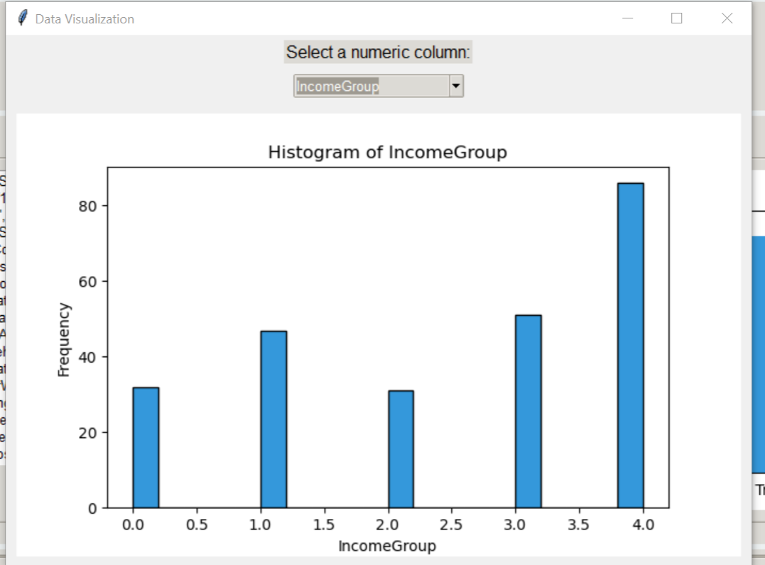
Model

Slide 10
Model Selection and Training/Testing
Models Employed:
Decision Tree: For initial analysis and feature importance evaluation.
Random Forest: To enhance accuracy and reduce overfitting.
Gradient Boosting: For fine-tuning predictions by combining weak learners.
Training Process:
Data is split into training and testing sets (using a test size of 20% and a fixed random state for reproducibility).
Cross-validation and hyperparameter tuning (via GridSearchCV) ensure optimal performance.
Visualization:
The application displays model performance using bar charts within an interactive Tkinter GUI.

Slide 11
Result

Slide 12
Evaluation Results
Model Performance:
Accuracy metrics for each model are logged and compared.
The best-performing model is identified and detailed (with accuracy scores and classification reports available).
Interactive Code Output:
The Python/Tkinter application provides real-time logs, interactive plots (e.g., histograms, scatter plots, correlation heatmaps), and detailed metrics screens.
Users can view predictions per data entry (using the 'ShortName' column) along with comprehensive visual feedback.
Visual Aids:
Bar charts of model accuracy.
Feature importance visualizations and scatter plots generated within the app.

Slide 13
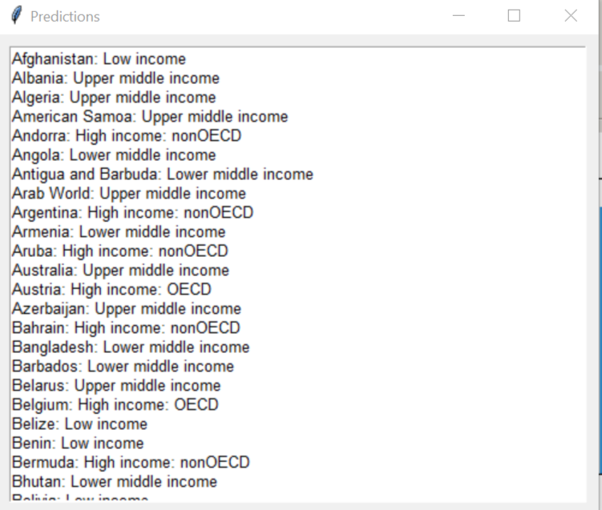
Deployment

Slide 14
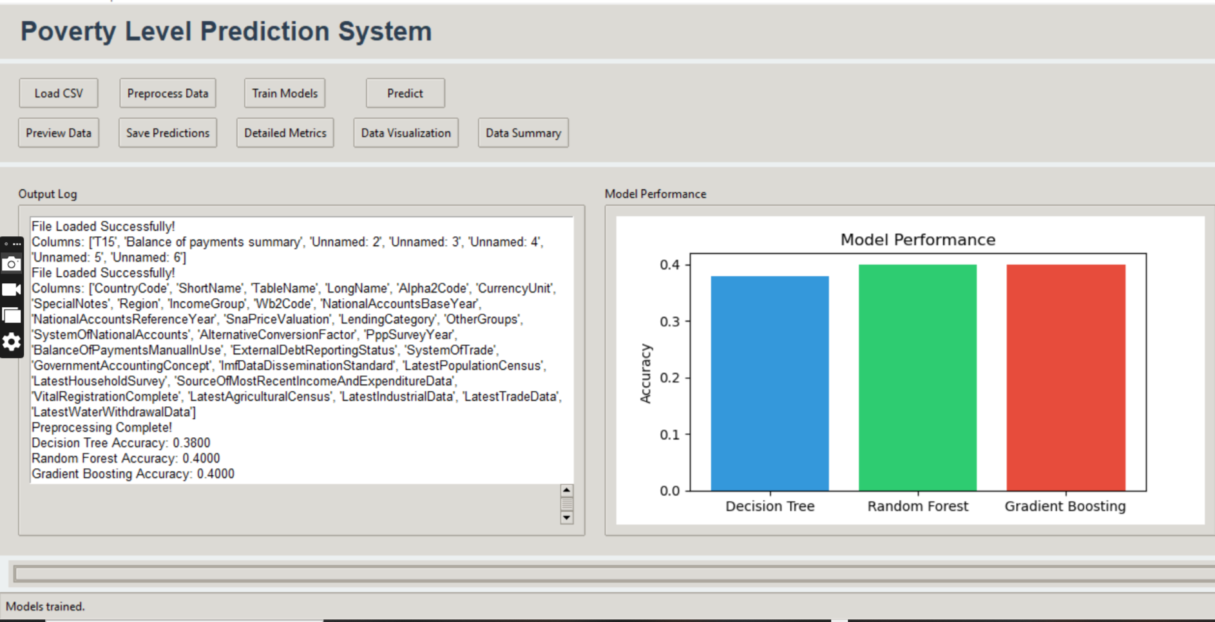
Deployment
Deployment Overview:
The project is implemented as a desktop application using Python’s Tkinter library.
Key Components:
GUI Interface: Allows users to load CSV data, preprocess it, train multiple models, and view predictions interactively.
Model Serialization & API Integration: (Planned future work) to enable web deployment or integration with other systems.
User Experience:
A built-in user guide, tooltips, and detailed logging help users navigate functionalities such as hyperparameter tuning and data visualization.

Slide 15
Conclusion and Futurework
Conclusion:
Successfully developed an end-to-end solution that predicts poverty levels using socioeconomic data from the World Bank.
The interactive GUI not only demonstrates model performance but also empowers users with data exploration and evaluation tools.
Future Work:
Interface Enhancements: Further refine the GUI for improved usability and add more dynamic visualizations.
Advanced Modeling: Explore deep learning approaches and ensemble methods to boost prediction accuracy.
Deployment Expansion: Integrate the application with a web-based API for real-time data updates and broader accessibility.
Final Thoughts:
The project’s code output and interactive features highlight its potential as a valuable tool for data-driven poverty alleviation strategies.

Slide 16

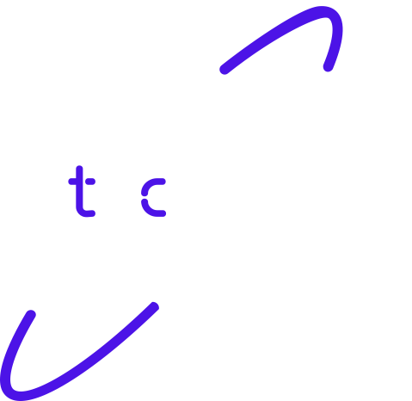
Thank you!

